Slide 1
Chain of Responsibility Pattern
Intent
Motivation
Applicability
Structure
Consequences

Slide 2
Intent
Avoid coupling the sender of a request to its receiver by giving more than one object a chance to handle the request.
Motivation
Often the requestor isn’t aware of the object that handles that request. A way to decouple the object that initiates the request from the object that serves it, is the motivation behind using a pattern like chain of responsibility. As the name suggests, the request gets passed along a chain of objects until one of them handles it.

Slide 3
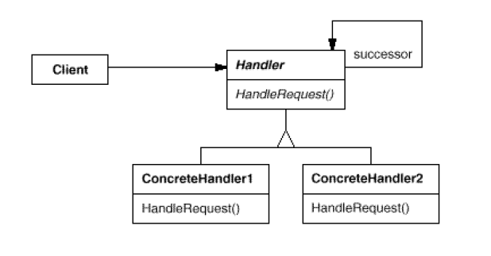
Applicability
When more than one object may handle a request, and the handler isn’t known a priori
When multiple objects can receive the request without either of them being specified explicitly
The set of objects that can handle a request should be specified dynamically
Structure

Slide 4
Consequences
Reduced coupling: The requestor doesn’t have to know which object will handle the request
Flexibility: Add or change responsibilities for handling a request by adding to or changing the chain at run-time
Guarantee: The request may fall off the chain without ever being handled. There’s no guarantee
Implementation
Implementing the successor chain – either using new links or existing links
Connecting successors – should there be a default implementation of handler request

Slide 5
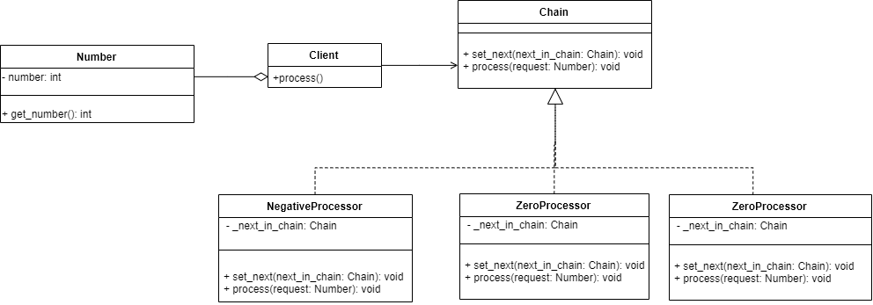
Current Example

